Slide 1
History
Angular 16 has been released on May 2023. Angular v16 is the culmination of this with dozens of refinement which leads to better developer experience and performance.
Developed by :- Google
Front end/Client Side Javascript Framework.
The Angular is the newest form of the AngularJs, Developed by Google, which is an open-source front-end development platform used for building mobile and desktop wen applications. Angular is the rewritten by the sample team the build AngularJs.
It is a Javascript framework for building web applications and apps in Javascript, HTML and Typescript, which is a superset Javascript. The Angular now comes with every latest feature you need to build a complex and sophisticated web or mobile application. It contain features like component, Dependency Injection and many more.
Angular is one of the popular framework for building client app with HTML, Javascript and Typescript.

Slide 2
Why Angular
Speed and Performance.
Smaller application.
Modular application.
Cross – platform (Web, Mobile and Desktop)
Single page application -→ as angular have only one index.html page
Use Typescript --→ Provides OOPs functionality

Slide 3
Main Building Blocks of Angular
Modules.
Components.
Templates
Metadata
Data binding
Directives
Services
Dependency Injection

Slide 4
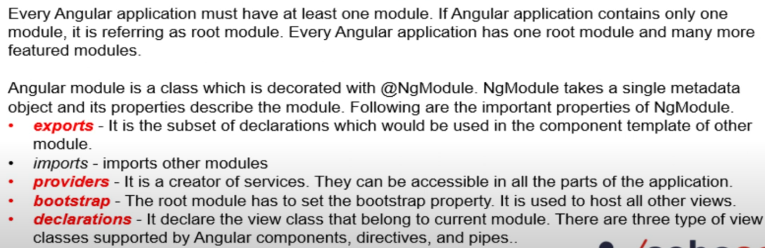
1) Modules
Example :- app.module.ts

Slide 5
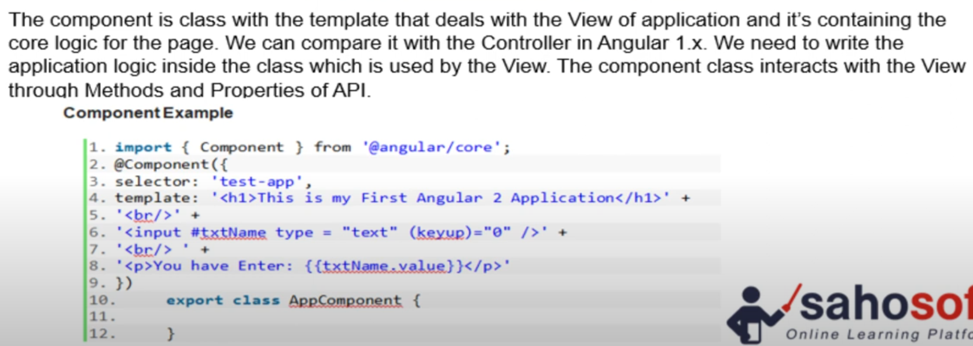
2) Component
Example :- app.component.ts

Slide 6
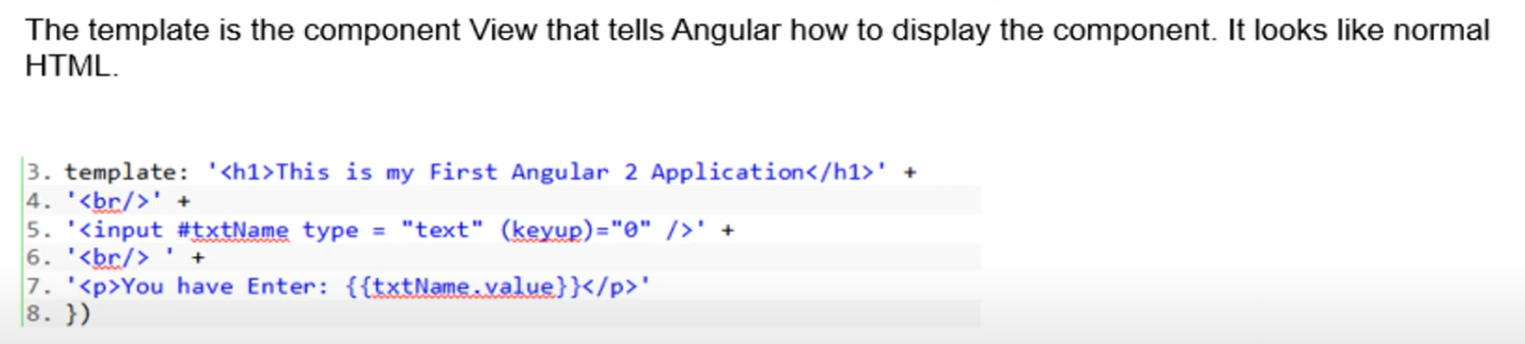
3) Template
Example :- app.component.html

Slide 7
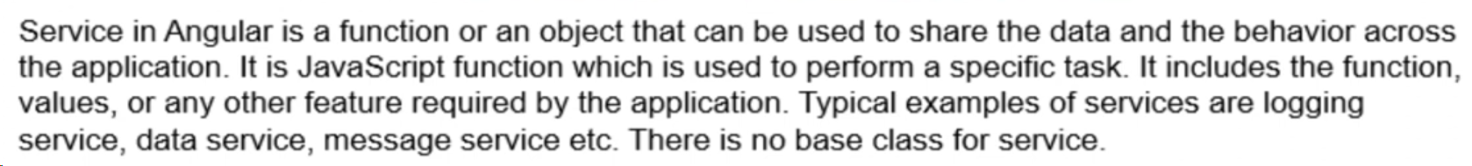
4) Service
1) Used to share property and function between components.
2) Used to avoid logic again and again
3) Write logic in Service.
4) And Used it in Component in which we want by creating object of service.

Slide 8
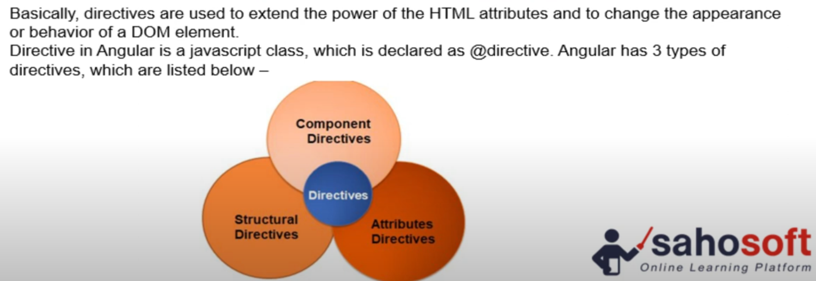
5) Directive

Slide 9
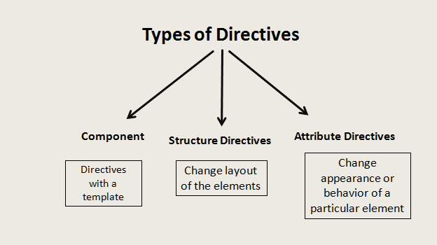
5) Directive

Slide 10
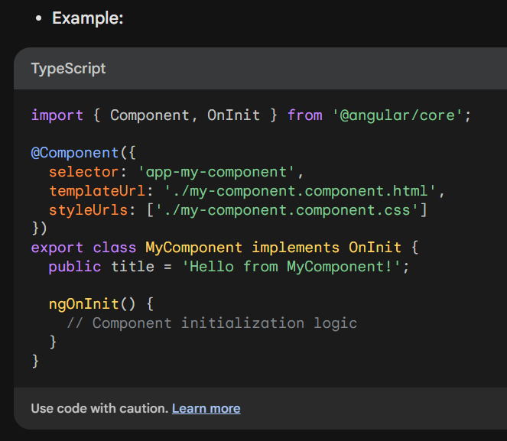
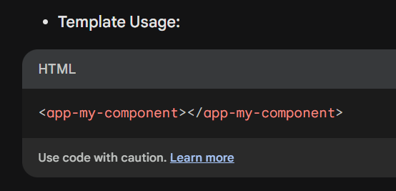
5) Directive
Component Directive :- Used to represent a UI component with a template, style, and behavior.
Acts as the building block of Angular application

Slide 11
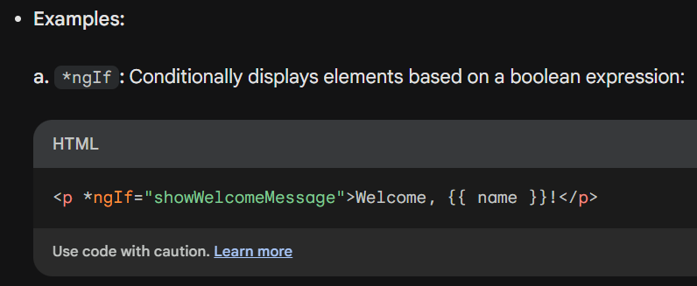
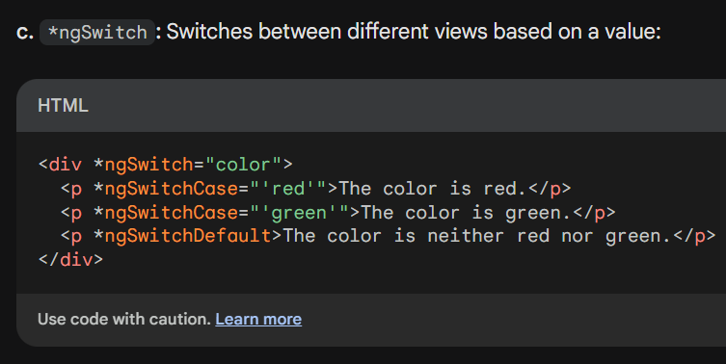
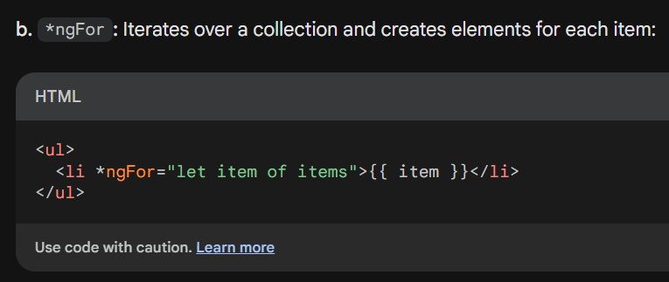
5) Directive
2) Structural Directive :- Modify the DOM structure by adding, removing, or transforming elements
based on data.

Slide 12
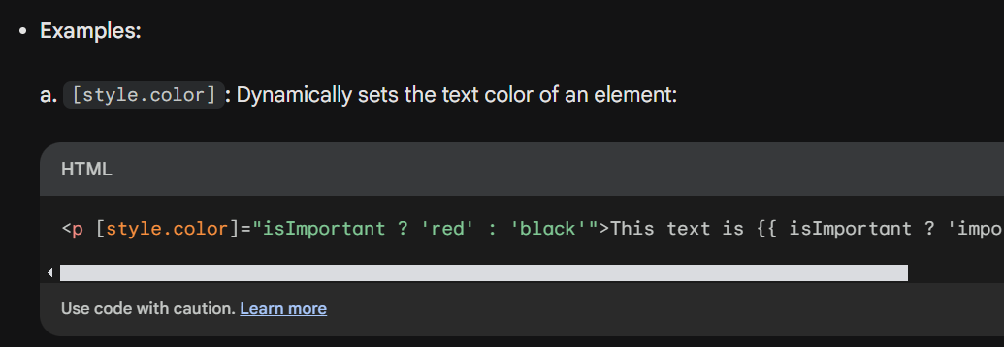
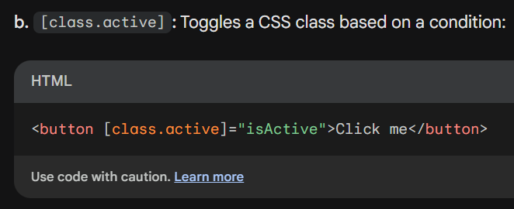
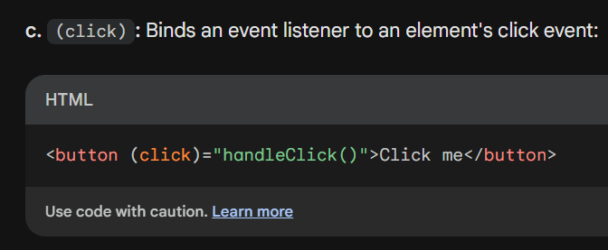
5) Directive
3) Attribute Directive :- Modify the appearance or behavior of DOM elements directly using custom
attributes

Slide 13
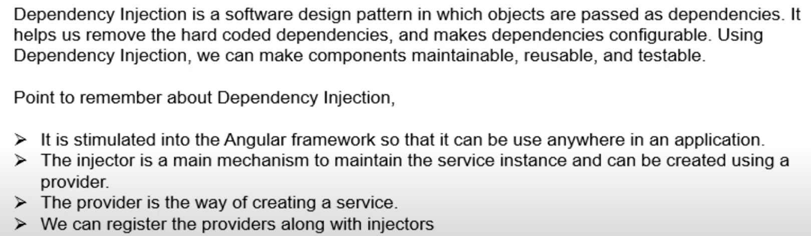
6) Dependency Injection

Slide 14
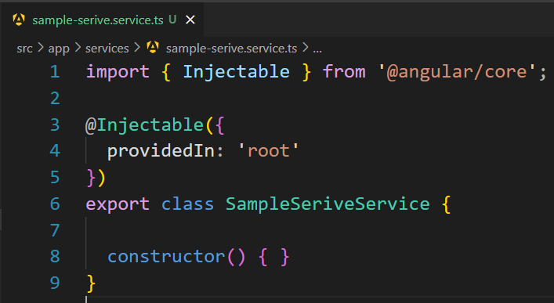
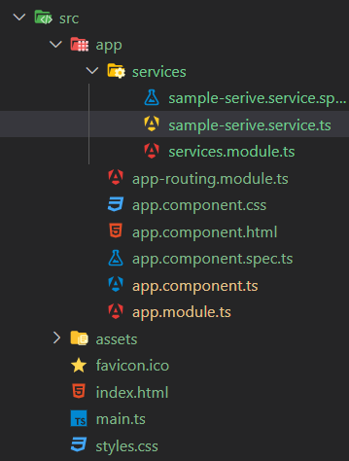
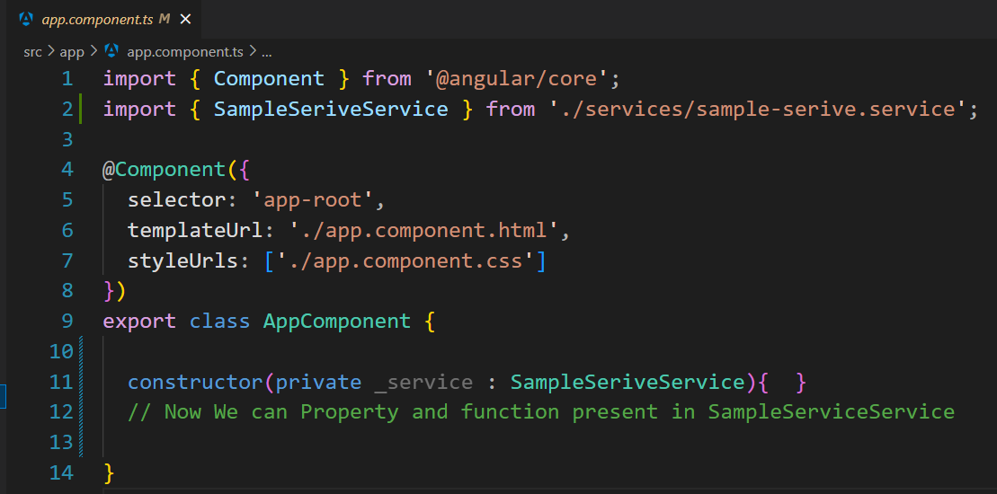

Slide 15
Angular Module
Module in Angular refers to a place where you can group the components, directives,
pipes, and services, which are related to the application.
In case you are developing a website, the header, footer, left, center and right section becomes part of a module.
Default module :- app.module.ts

Slide 16
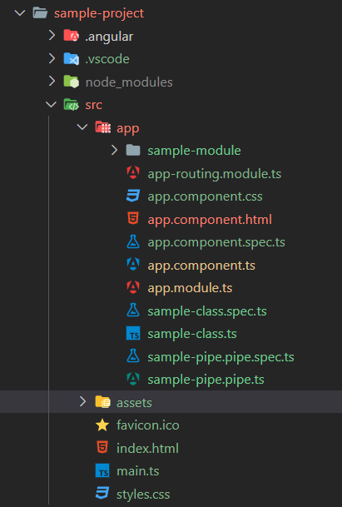
Angular Module
declaration: [
AppCoponent,
// Use to import Component
],
imports: [
BrowserModule,
// Use to Import Module
],
providers: [
SampleClass,
SamplePipePipe,
SampleModuleModule
// Use to available class, pipe & module across module
],
exports: [
AppleComponent,
// Use to export component to parent module which import this module
]

Slide 17
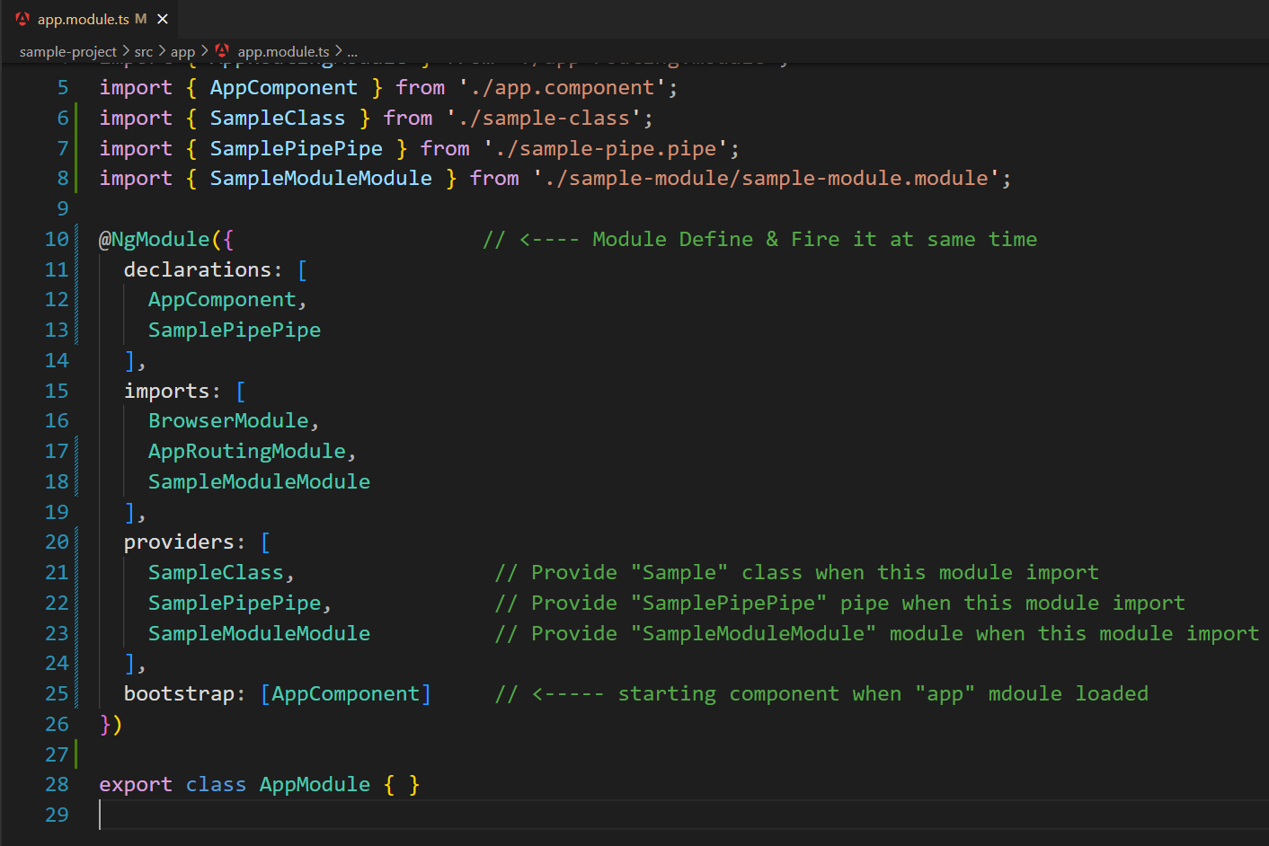
Angular Module

Slide 18
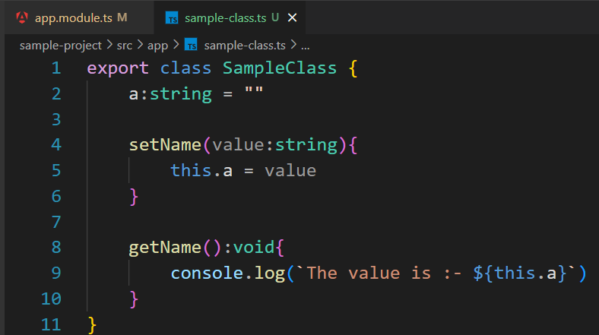
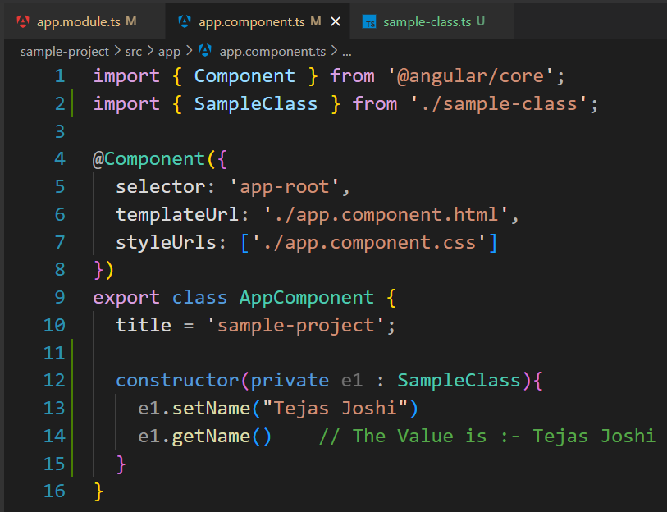
Angular Module

Slide 19
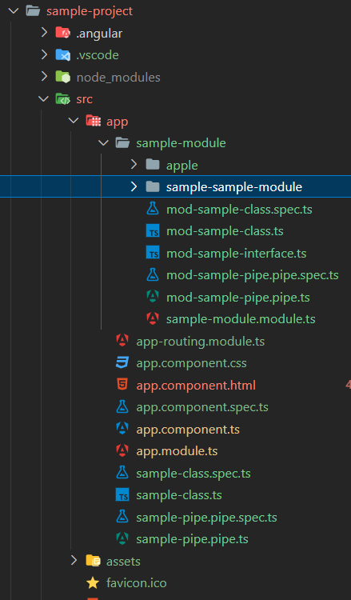
Angular Module
Feature Module

Slide 20
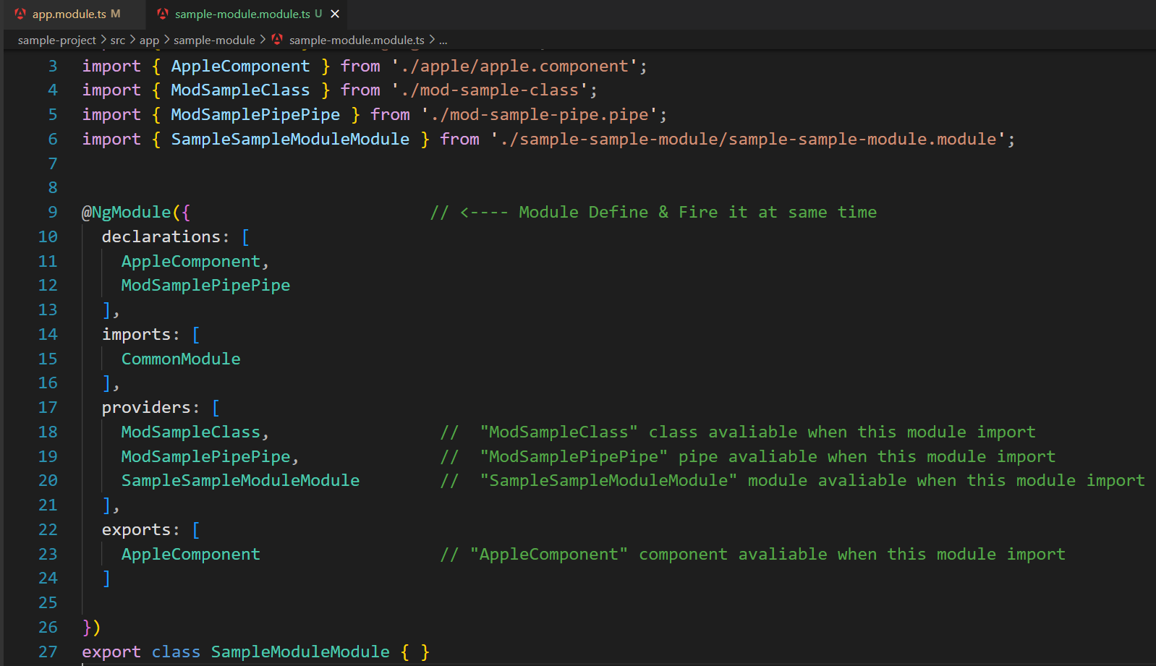
Angular Module

Slide 21
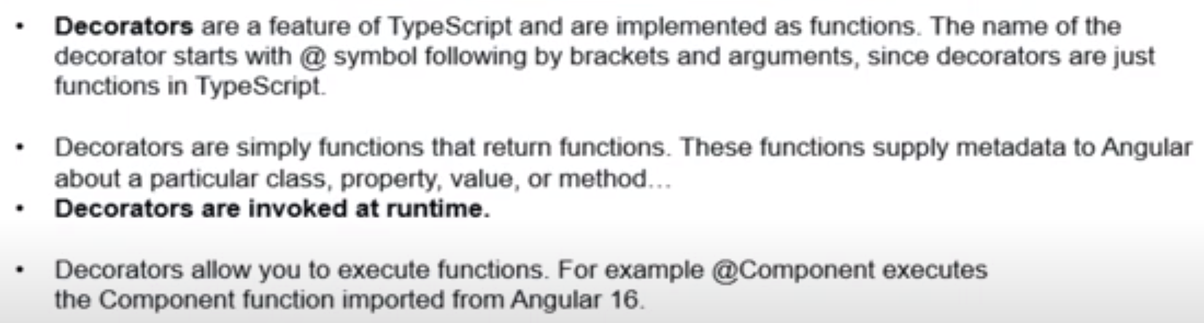
Angular Decorator

Slide 22
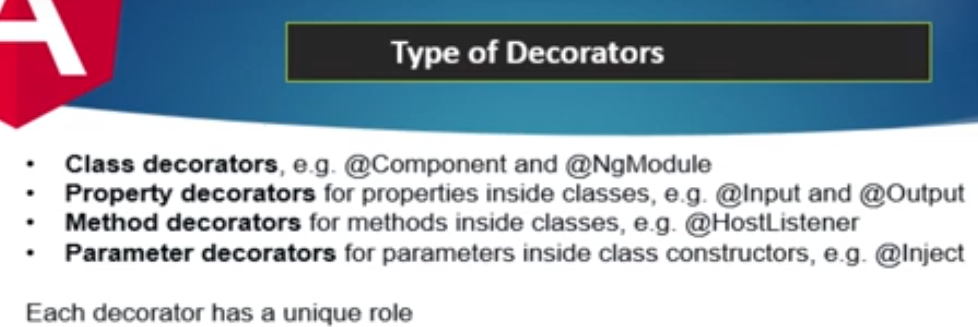
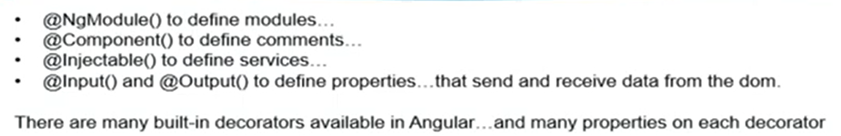
Angular Decorator
Example :-
components

Slide 24
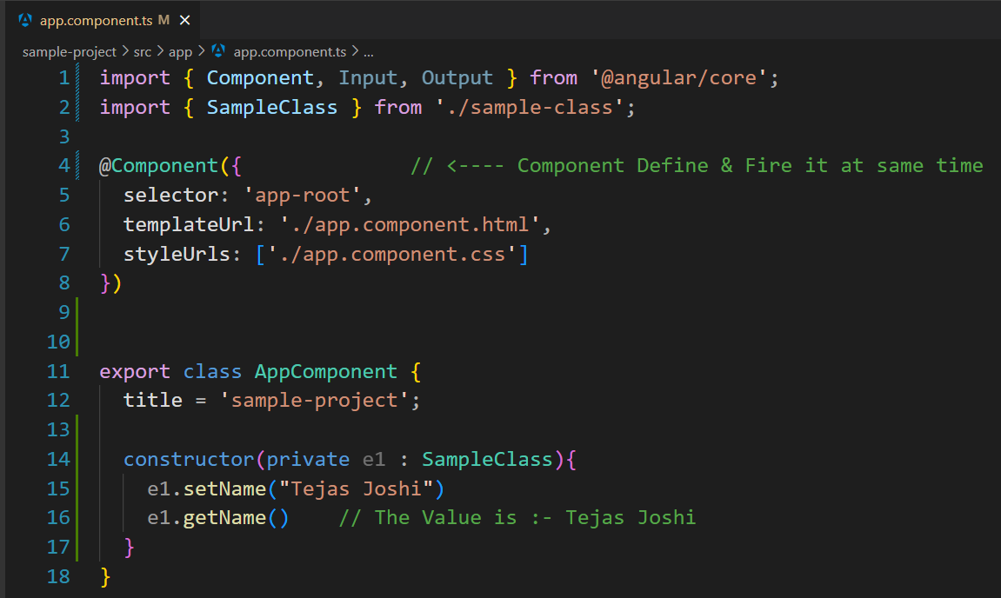

Slide 25
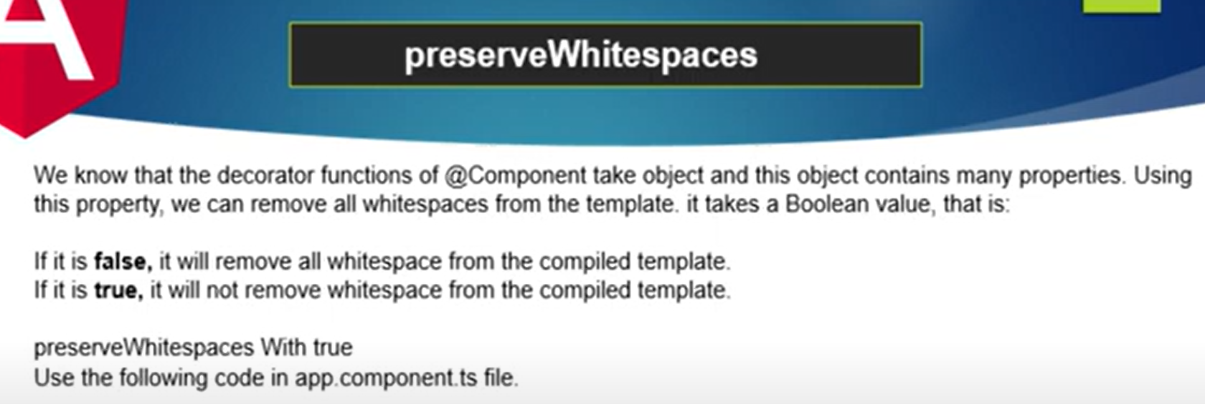
preserveWhitespaces :- Metadata of @component decorator

Slide 26
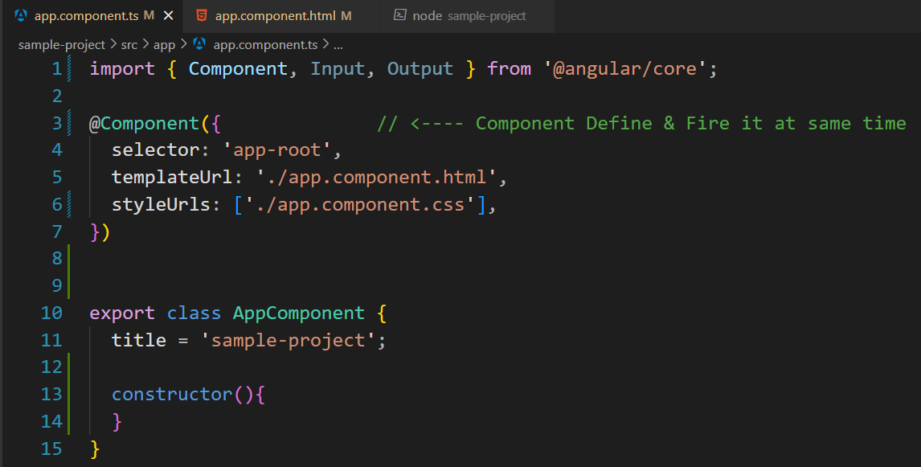
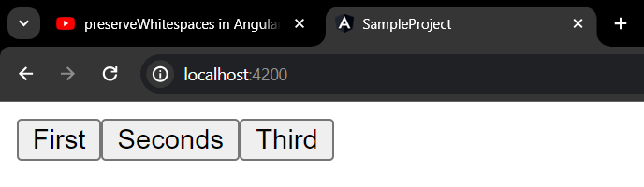
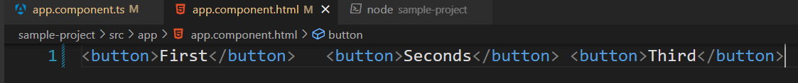

Slide 27
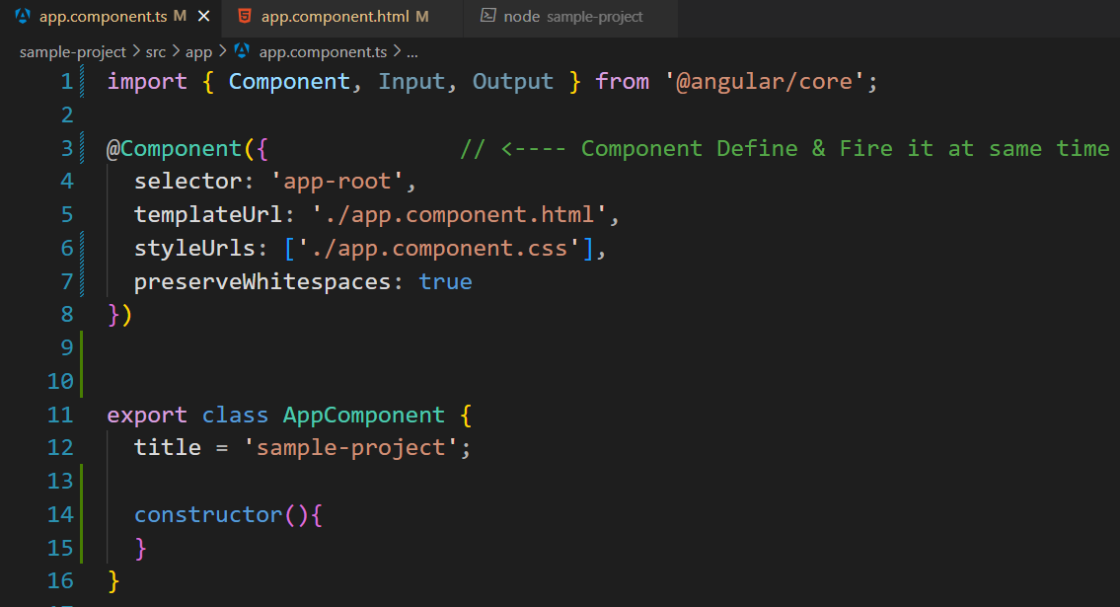
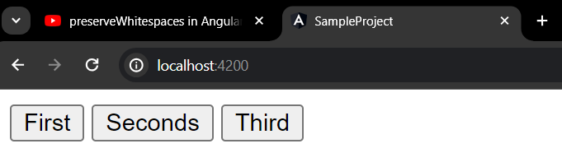

Slide 32
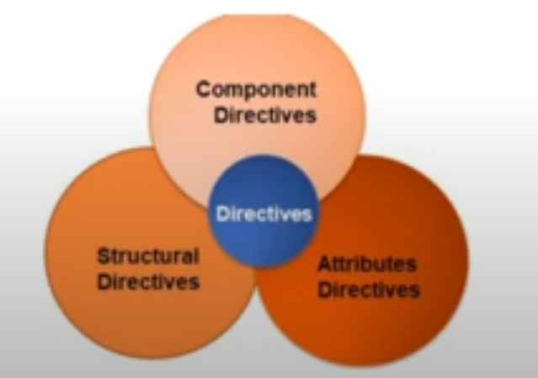
Directive
Basically, directives are used to extend the power of the HTML attributes and to change the appearance or behavior of a DOM element.
Angular has 3 types of directives, which are as follows :-

Slide 33
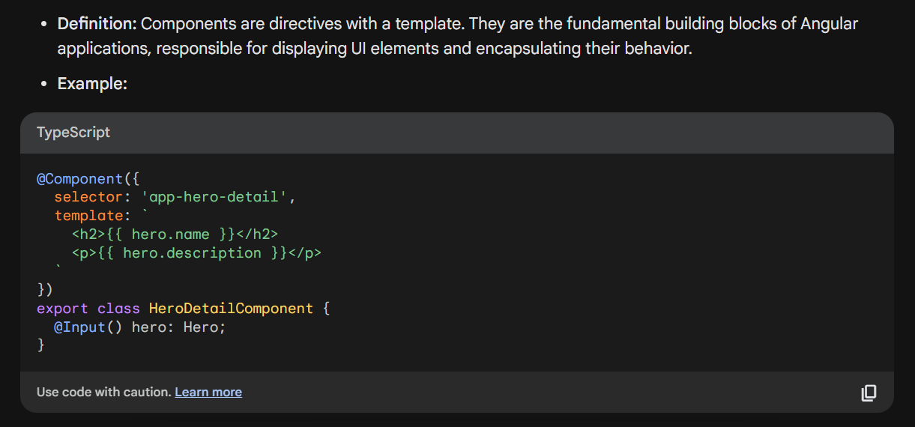
1. Component Directive

Slide 34
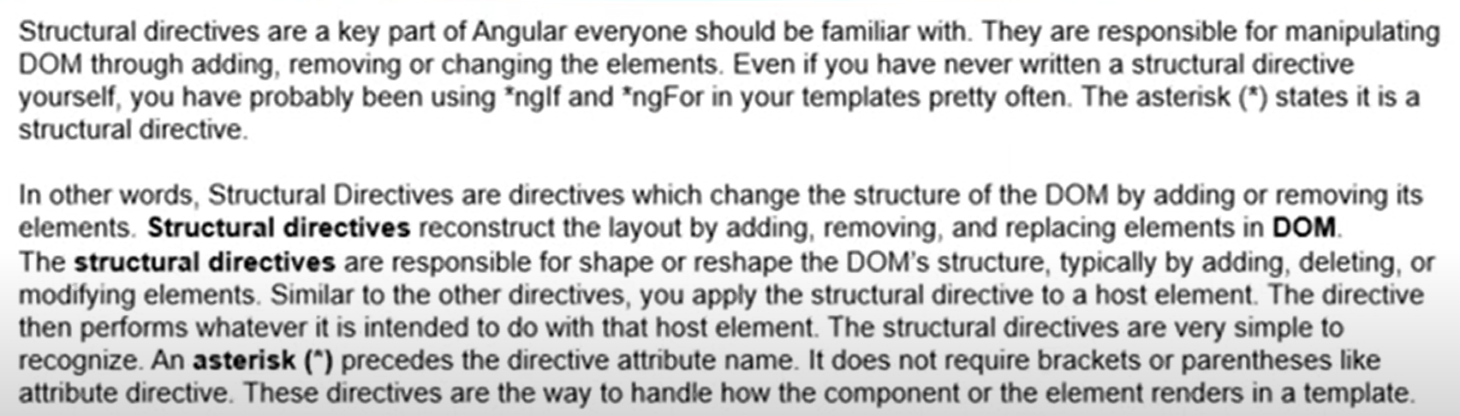
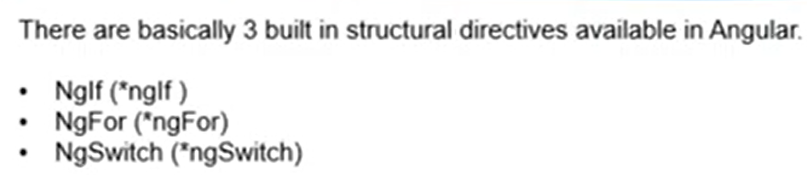
2. Structural Directive

Slide 35
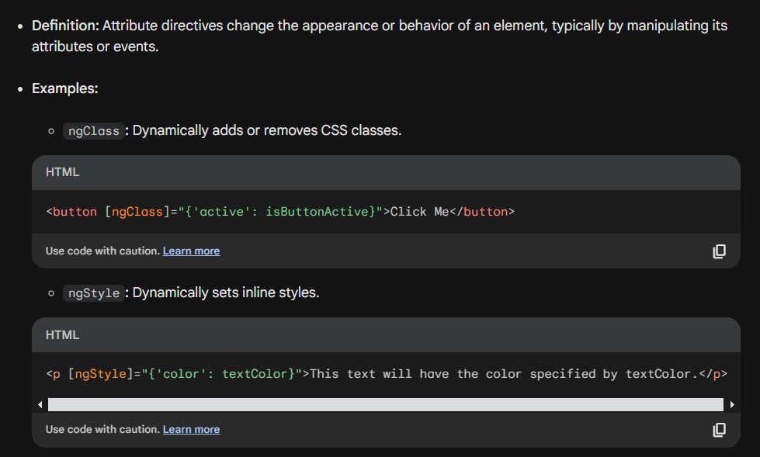
3. Attribute Directive

Slide 36
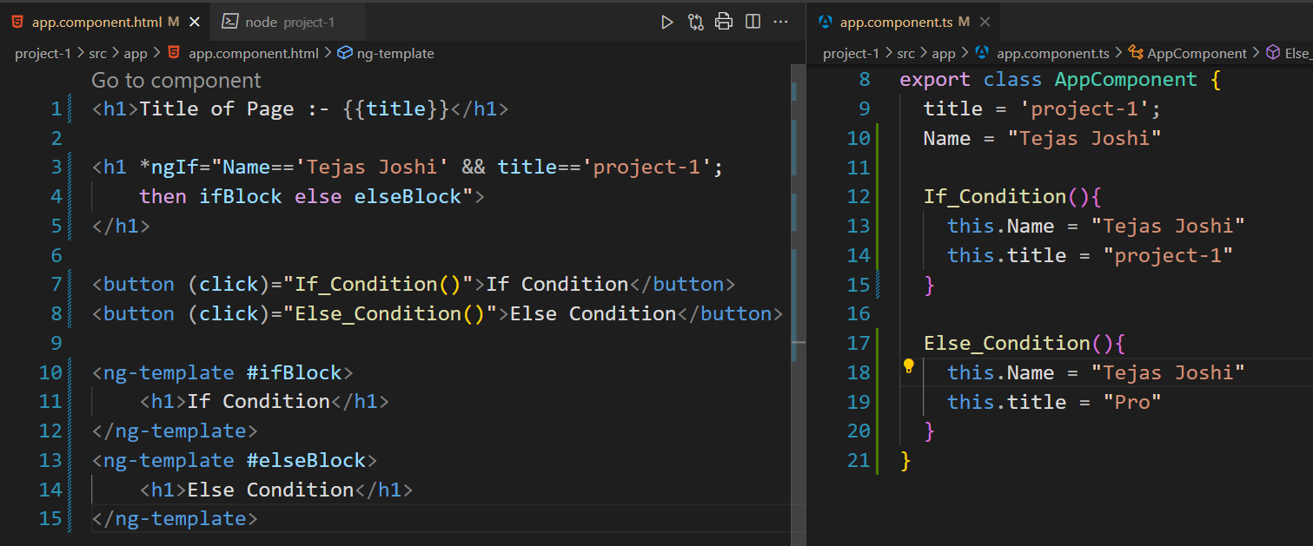
If-else Condition

Slide 37
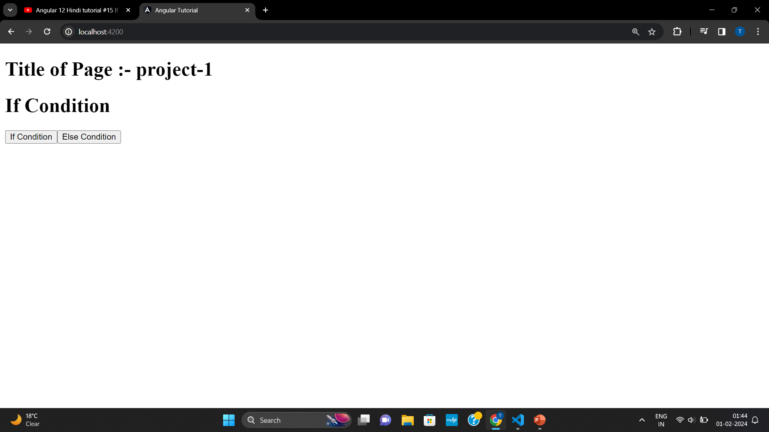
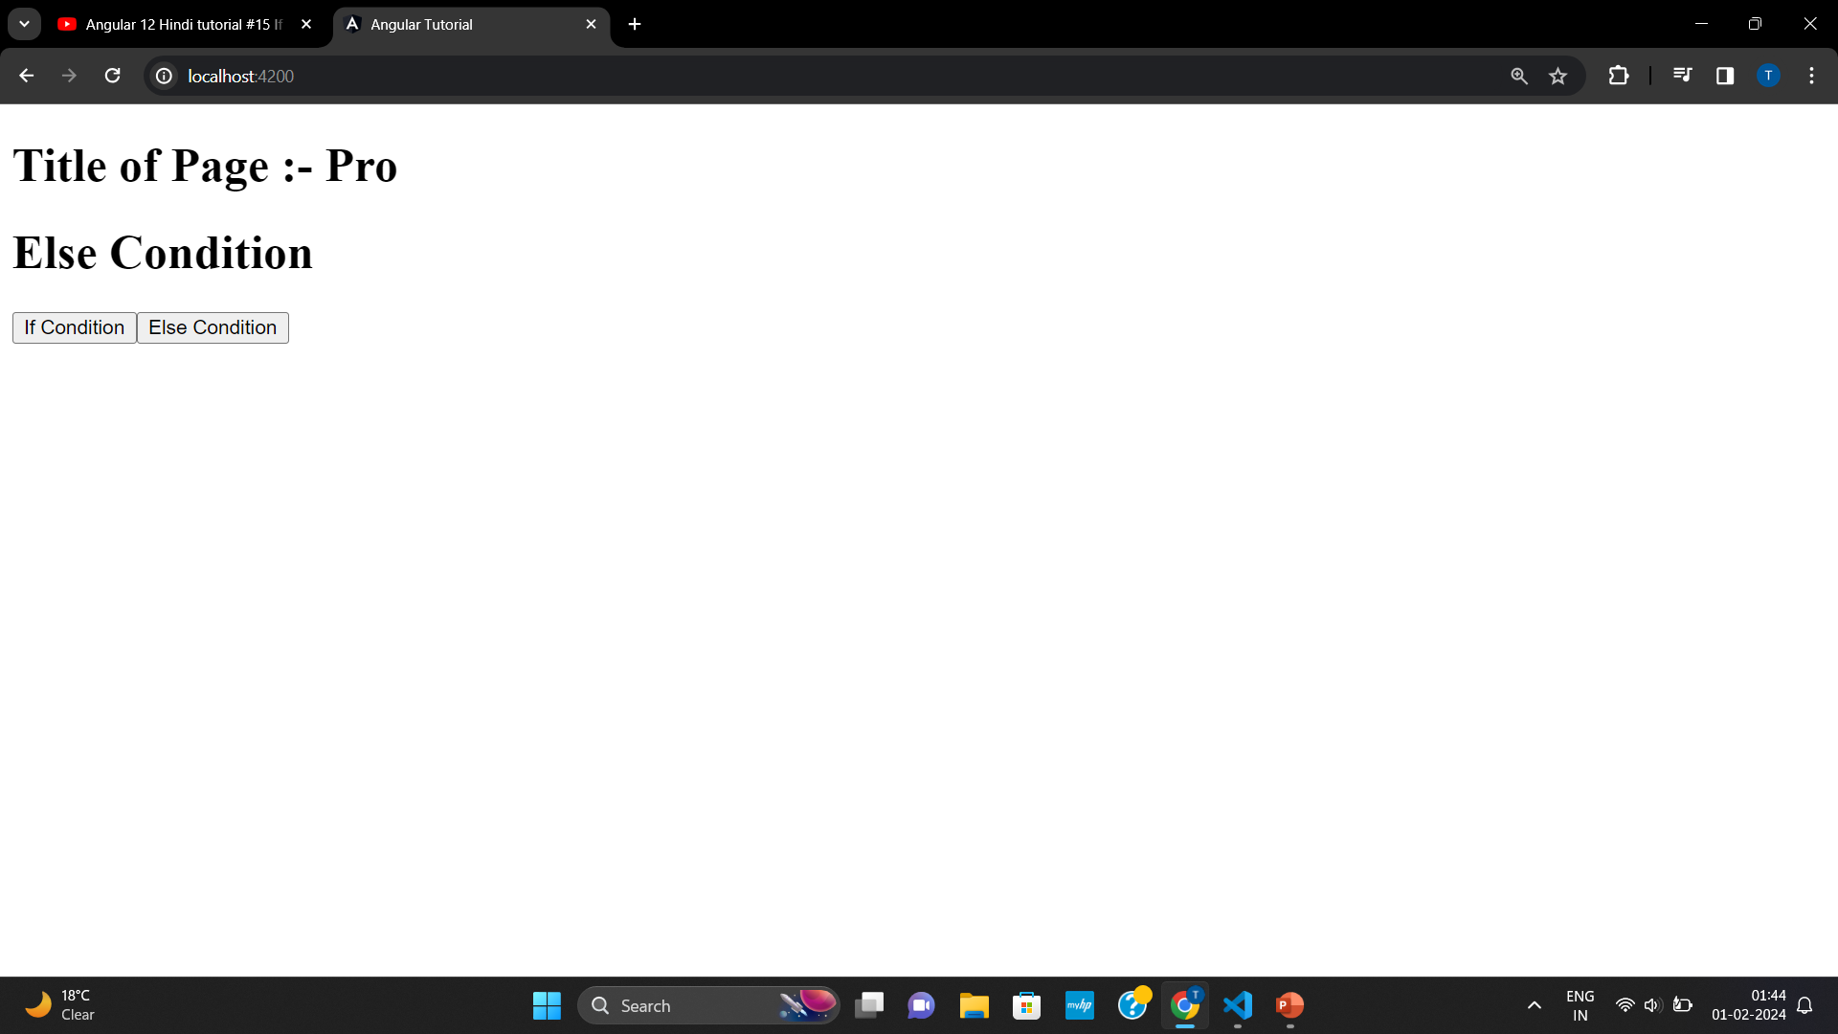
If-else Condition

Slide 38
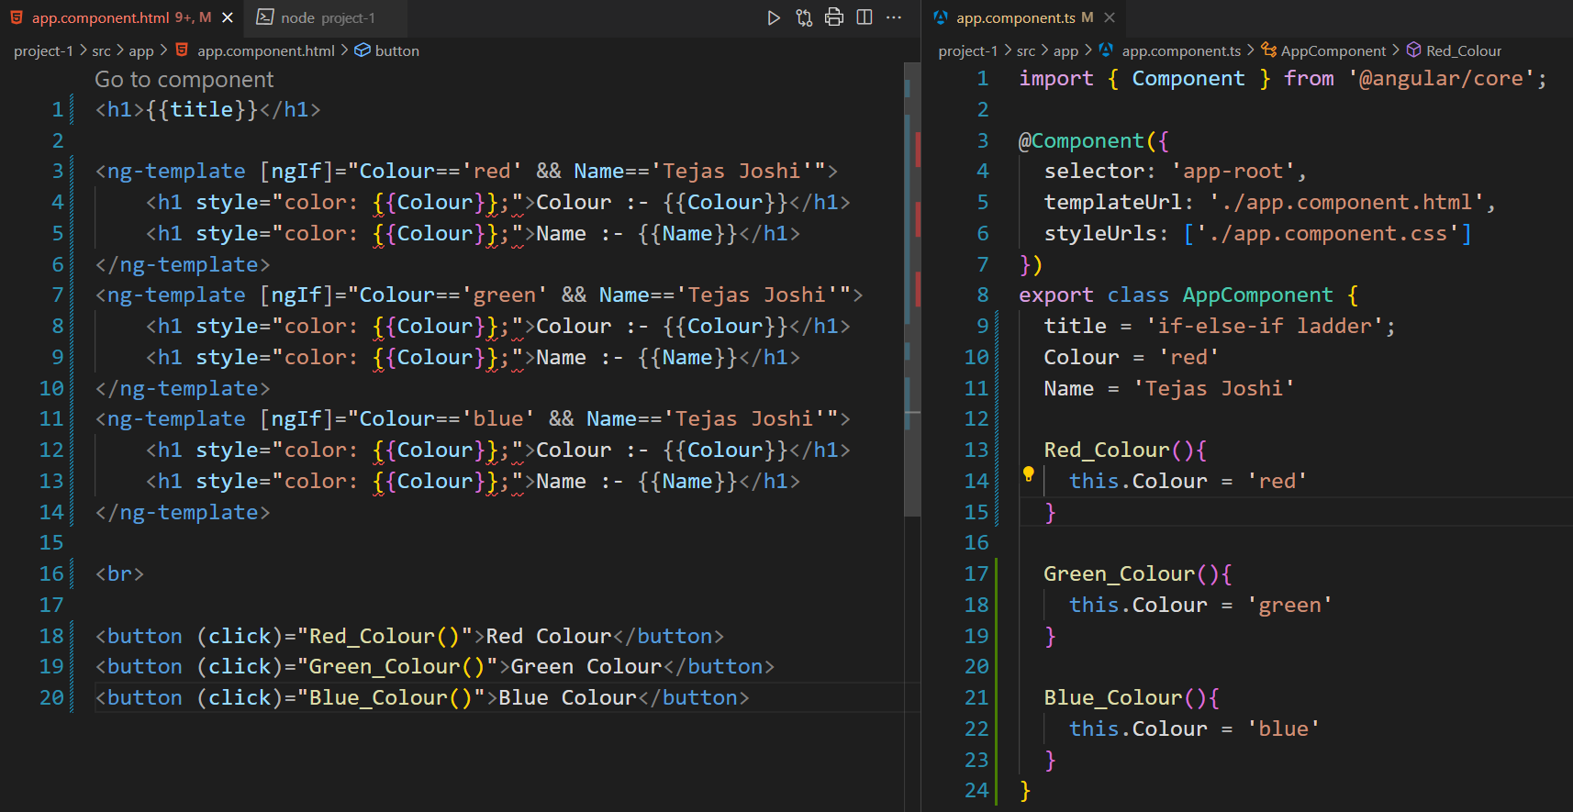
If-else-if ladder
If-else-if ladder not present in angular, we have to manually use if condition else we can user switch case condition

Slide 39
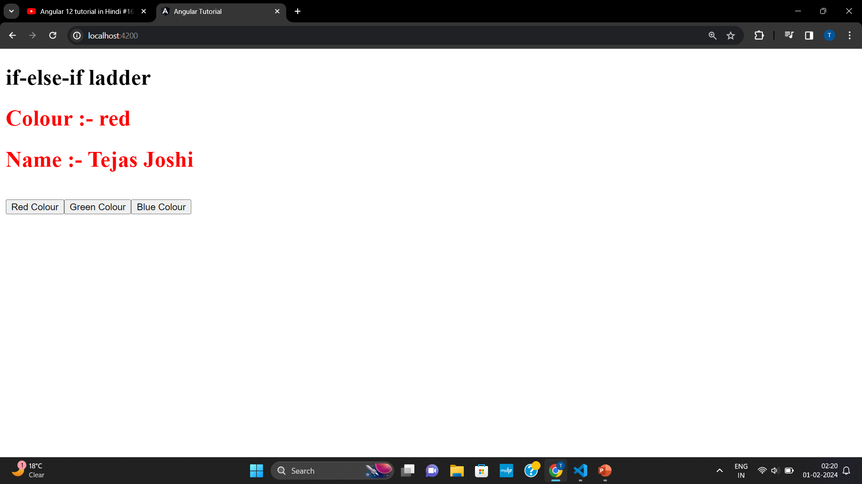
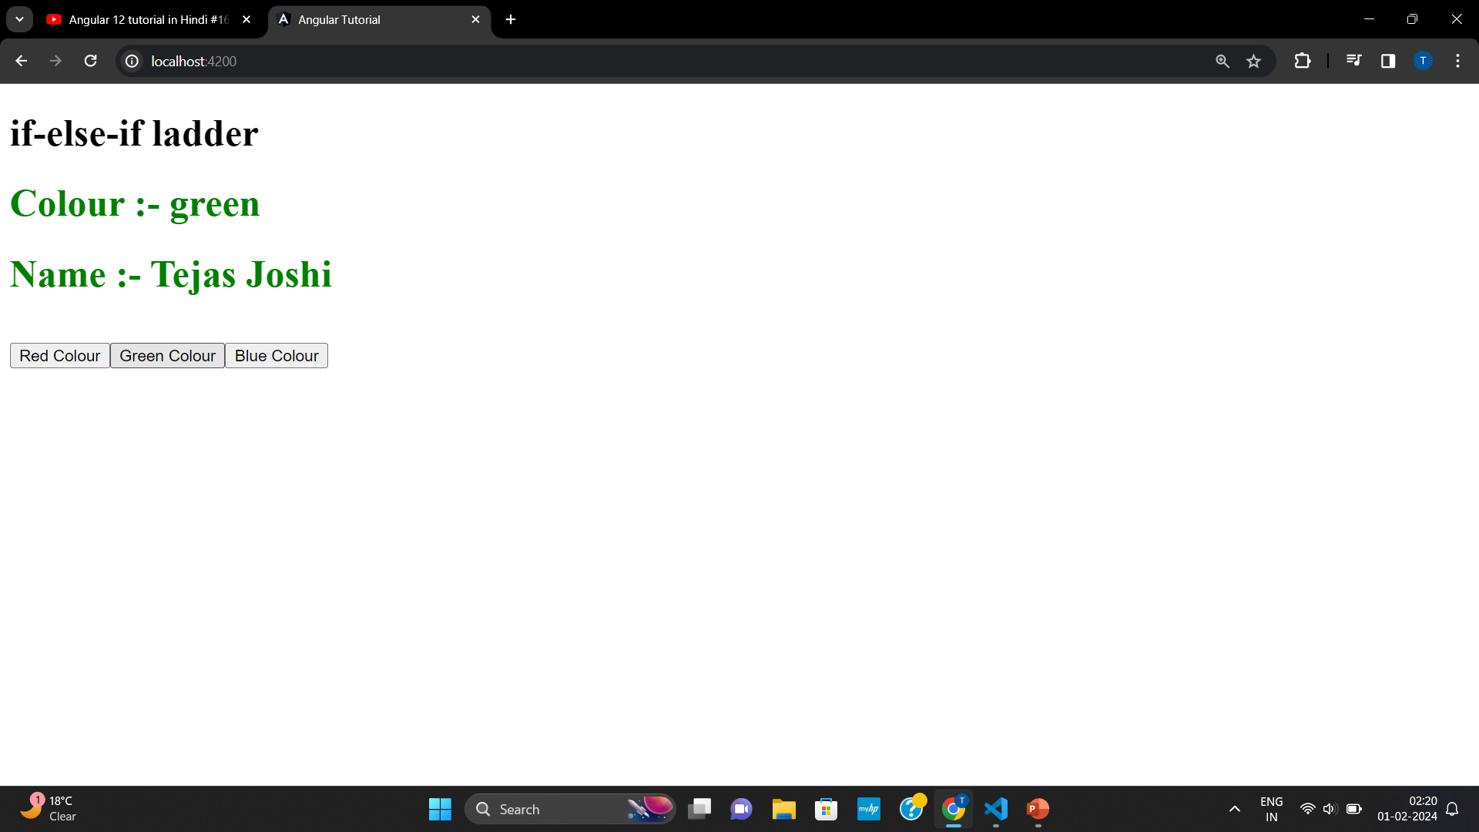
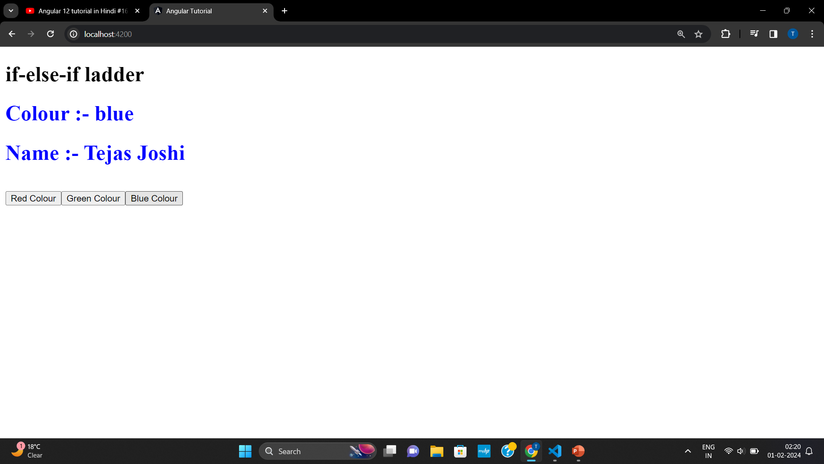
If-else-if ladder

Slide 40
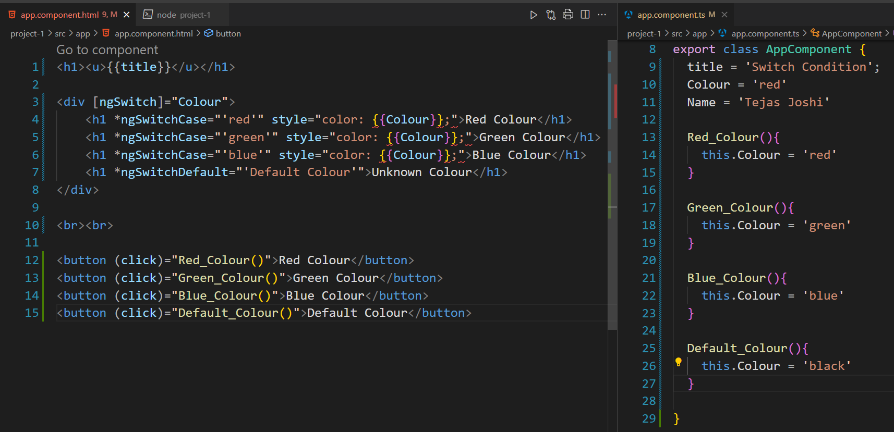
Switch Case

Slide 41
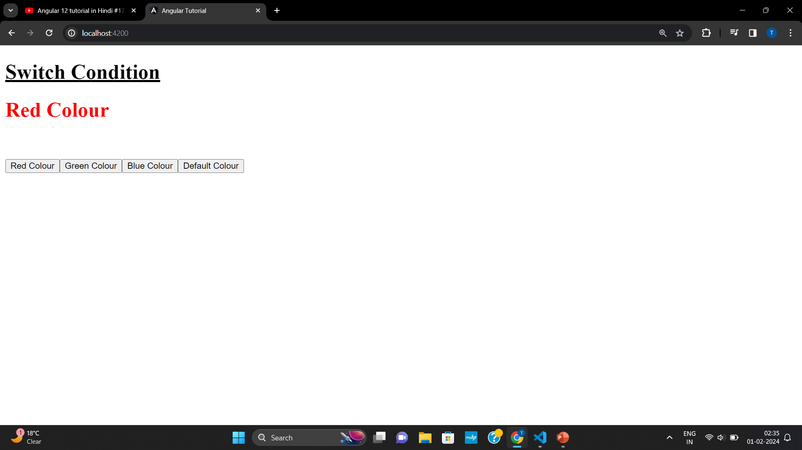
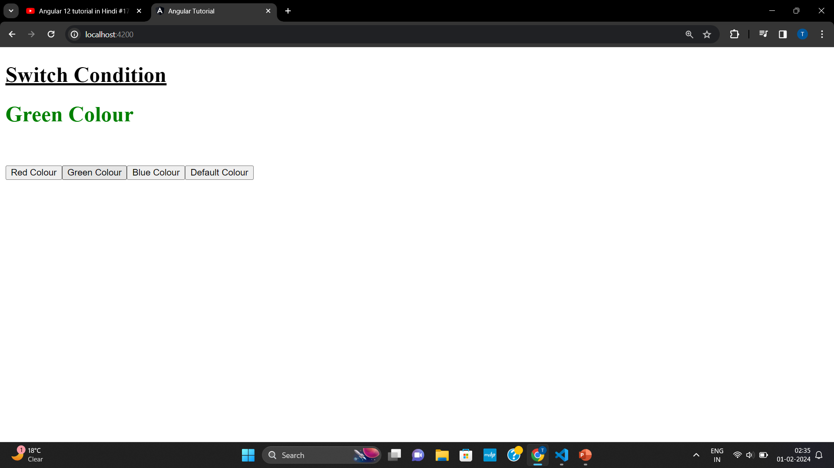
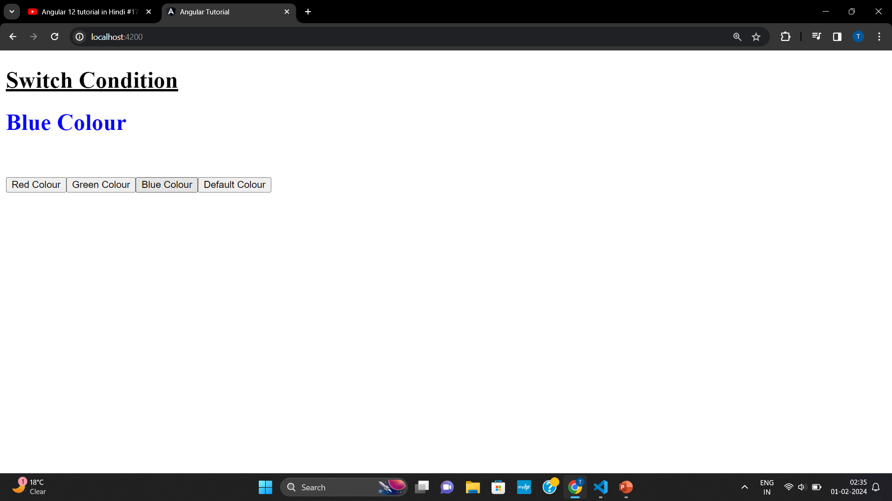

Switch Case

Slide 42

ngFor
Note :- Indexing starts from 0

Slide 43


Slide 44



Slide 45
TrackBy with ngFor
*ngFor loads all data even if one row is added
TrackBy track the old data and load only those rows which newly added in dataset
This improves speed of our website.

Slide 46


Slide 47




Slide 48



Grouping with ngFor

Slide 49

ngStyle

Slide 50




Slide 51
ngClass
ngClass directive allows us to set the CSS class dynamically for a DOM element.
ngClass with string
ngClass with array
ngClass with object
ngClass with component method

Slide 52



1) ngClass with string

Slide 53

2) ngClass with array

Slide 54

3) ngClass with object

Slide 55


4) ngClass with component method

Slide 56

Data Binding
Data Binding means to bind the View (HTML content) with Controller’s (Component’s) field . That is whenever we display dynamic data on a view (HTML) fro Component, data binding is used.
Data Binding basically means interacting with data. So, we can say that the interaction between templates and business logic is called data binding.

Slide 57
Data Binding
One-way Binding
Two-way Binding
Component to View
Interpolation Binding
Property Binding
Style Binding
Class Binding
Attribute Binding
View to Component
Event Binding
Component :- app.component.html
View :- app.component.ts

Slide 58
Data Binding types can be grouped into three categories distinguished by the direction of data flow :-
Source (Component) to View
View to Source (Component)
Two-way sequence :- View-to-Component & Component-to-View

Slide 59

Interpolation
Interpolation is a technique that allows the user to bind a value to a UI element.
Interpolation binds the data one-way. This means that when value of the field bound using interpolation changes, it is updated in the page as well. It cannot change the value of the field
The Format for defining interpolation in a template is :- {{ propertyName }}

Slide 60


Interpolation

Slide 61

Interpolation

Slide 62
Property Binding
It is used to bind values of component/model properties to the HTML element.
Depending on the values, it will change the existing behavior of the HTML element.
Syntex - [property] = ‘expression’
In property binding, there is source and target. For this example, we can define it as [innerHTML] = ‘firstname’. Here, innerHTML is a target that is a property of span tag and source is a component property i.e. firstname

Slide 63

Note :- Property Binding is much better than Interpolation
Interpolation takes true as true
Interpolation takes false as string i.e. true --→ Issue

Slide 64

Property Binding VS Interpolation

Slide 65

Property Binding VS Interpolation

Slide 66
Attribute Binding
With Attribute Binding, we can set the value of an attribute directly. The thing to note is that you must use the attribute binding only when there is no element property there to bind.
Attribute binding is used to bind attribute of an element with the field of a component
<td [attr.colspan]=“myCollSpan” align=“center”> Employee’s Records </td>

Slide 67




Slide 68
Event Binding
When a user interact with an application in the form of a keyboard movement, a mouse click, or a mouseover, it generate an event. These events need to be handled to perform some kind of action. This is where event binding comes into picture.
Syntex :-
Within parenthesis on the left of the equal sign, we have the target event (“click”. In this case) and on the right side, we have the template statements such as component properties and methods <button (click)=“onClick()”> Click on Me</button>
In this case, the onClick() method of the component class is called when the click event occur

Slide 69


Slide 70

Two-way Binding
The most popular and widely used data binding mechanism is two-way binding in the angular framework. Basically two-way binding mainly used in the input type field or any form element where user type or provide any value or change and control value in the one side, and on the other side, the same automatically updated in to the controller variables and vice-versa.

Slide 71







Slide 77
Routing
Routing is mechanism used by angular for navigating between page and displaying appropriated component/page on browser.
Angular framework is mainly focused and good for the SPA (Single-Page Architecture). It loads a single full HTML page and dynamically loads or updates the partial pages as per user request And, that is achieved with the help of router. A set of partial page loading rule and URLs is defined in router to render or load partial pages based on user request.
Angular routing helps navigation across the application from one view to another view. It also allows us to maintain the sate, implement modules, and load the modules based on the role of the user.

Slide 78
In Component based architecture of Angular 16, Angular looks into the routes array, match the path as per the route requested and loads the component relevant to the requested route as well as makes available the relevant data for the particular route.
Angular provides as easy way to create and work with components, in a single page application (SPA) if is essential to work with multiple views/screens, navigate and communicate between them. Angular provides router service to manage this in a very easy way.
An Angular application that uses Angular Router only has one router service instance. It’s a singleton Whenever and whenever you inject the Router service in your application, you’ll get across to the same Angular Router service instance.

Slide 79
We access our application through one URL such as http://localhost:4200 and our application is not aware of any other URLs such as http://localhost:4200/login
Most web application need to support different URLs to navigate users to different pages in the application. That’s where router comes in.
Angular Router is an official Angular routing library., written and maintained by the Angular Core Team. It’s Javascript router implementation that’s designed to work with Angular and is packaged as @angular/router
First of all, Angular Router takes care of the duties of a Javascript router
It activates all required Angular components to compose a page when a user navigates to a certain URL. It lets users navigate from one page to another without page reload
It updates the browser’s history so the user can use the back and forward buttons when navigating back and forth between pages.

Slide 80
Angular Router allows us to :-
Redirect a URL to another URL
Resolve data before a page is displayed
Run scripts when a page is activated or deactivated
Lazy load parts of our application

Slide 81


How Router Works in Angular 16

Slide 82



Slide 83



Slide 84


Router Outlet in Angular 16

Slide 85

Router Link Angular 16
Template :-
<h1>Angular Router</h1> <br/><br/> <a [routerLink] = “[‘/student’]”>Student</a>
<router-outlet></router-outle>

Slide 86


Slide 87



Slide 88


Slide 89



Slide 90









Slide 91



Slide 93


Service
Creating Single-ton Object :-
All Object of service share same property and its value

Slide 94



Slide 95



Slide 96





Slide 97

Service
2) Creating Multiple Object :-
All Object of service share same property and but different value

Slide 98


Slide 99


Slide 100





Slide 106


Forms

Slide 107

1. Template-driven Form :-

Slide 108

2. Model-driven Form(Reactive Form) :-

Slide 109
Which is Better
Neither Reactive nor Template Dirven are better over each other. They both are different approaches, So you can use whichever suits your needs the most. You can even use both in the same application.
Most Powerful :- Reactive Forms

Slide 110

Reactive Form

Slide 111


Slide 112


Slide 113



Slide 114


Slide 115



Slide 116


Slide 117


Slide 118

Validation in Reactive Form

Slide 120



Slide 122






Slide 123


Get value & Reset value in Reactive Form

Slide 126


Slide 127


Slide 128



Slide 129





Slide 130



Slide 131

Set value & Patch value in Reactive Form
If we want to set value of each form control then only use setValue() as we cannot omit any form control in setValue( )
If we want to assign only few form controls of FormGroup then use patchValue( )

Slide 132





Slide 133


Slide 134


Slide 135


Slide 136



Slide 137


valuechange Reactive Form

Slide 138




Slide 139


Slide 140



Slide 142



Slide 143

statuschange Reactive Form

Slide 145



Slide 148







Slide 154

Module Loading in Angular 16

Slide 155


1) Eager Loading

Slide 156



Slide 157


Slide 158



Slide 159

In Eager Loading, All modules are loaded at starting time of loading website means when we hit “ng serve” all modules are loaded but components inside this modules are loaded only when they are called only AppComponent is loaded at start

Slide 160

2) Lazy Loading

Slide 161


Slide 162


Slide 163


Slide 164


Slide 165


Slide 166





Slide 167





Slide 168

3) Preloading Loading

Slide 169


Slide 170



Slide 171


3) CustomPreloading Loading

Slide 172



Slide 173



Slide 178

Observable & Subscribe Angular 16

Slide 179



Slide 180

Method | Description
Get | Fetch the Data
Post | Post the Data
Put | Update the D
Delete | Delete the Data

Slide 181


Slide 182


Observable & Subscribe with Angular Web API

